Slide 1
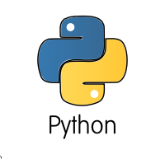
Python tutorial: Installation & basic syntax
Research Group Meeting
07/25/2017
Mustafa Dogan

Slide 2
Tutorial outline
Software installation
Basic syntax & arithmetic operations (+,-,*,/)
Strings
List, set, dictionary, array, and data frame
If statements
Loops: for, while, enumerate
Load and save data (csv, text)
Plotting & data visualization

Slide 3
Python programming language
Widely used high-level programming language for general-purpose programming
a design philosophy which emphasizes code readability
a syntax which allows programmers to express concepts in fewer lines of code
constructs intended to enable writing clear programs

Slide 4
The core philosophy of the language import this
Beautiful is better than ugly.
Explicit is better than implicit.
Simple is better than complex.
Complex is better than complicated.
Flat is better than nested.
Sparse is better than dense.
Readability counts.
Special cases aren't special enough to break the rules.
Although practicality beats purity.
Errors should never pass silently.
Unless explicitly silenced.
In the face of ambiguity, refuse the temptation to guess.
There should be one—and preferably only one—obvious way to do it.
Although that way may not be obvious at first unless you're Dutch.
Now is better than never.
Although never is often better than right now.
If the implementation is hard to explain, it's a bad idea.
If the implementation is easy to explain, it may be a good idea.
Namespaces are one honking great idea—let's do more of those!

Slide 5
Downloading Software
Anaconda distribution includes almost all packages you will need to run Python
Link to software (or just google Anaconda)
https://www.continuum.io/downloads
(Python 3+ is recommended)

Slide 6
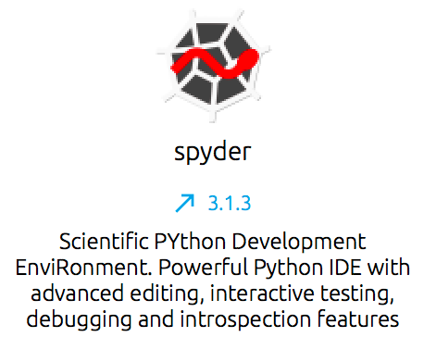
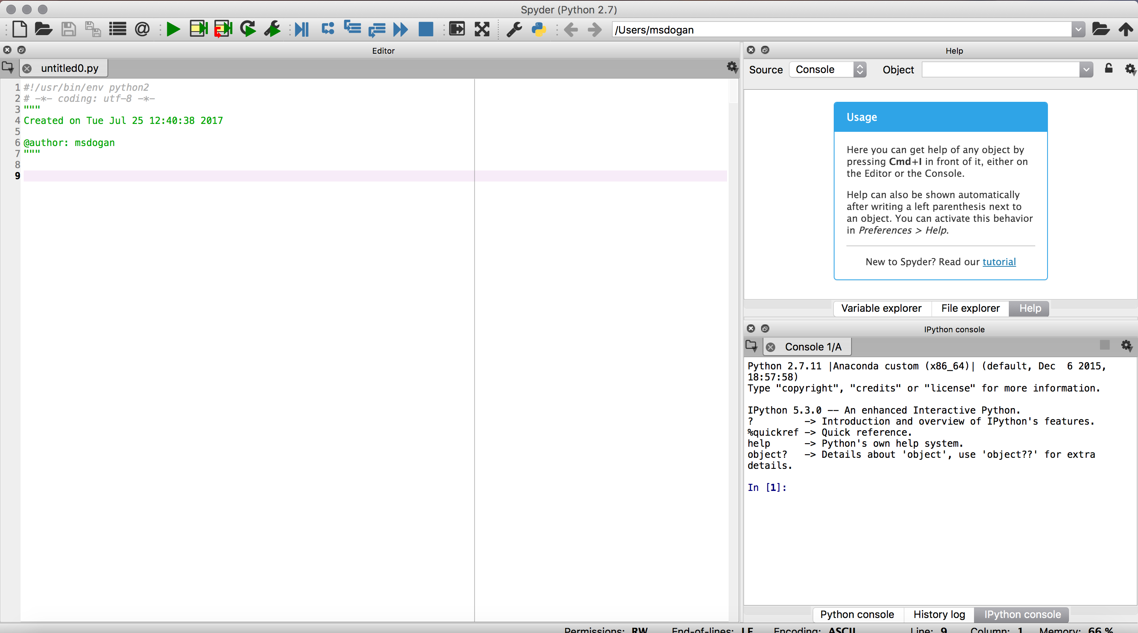
Using Python with Spyder IDE
After installing Anaconda distribution open spyder
Spyder is an open source cross-platform integrated development environment (IDE) for scientific programming in the Python language
Similar to Matlab, there is script editor and console

Slide 7
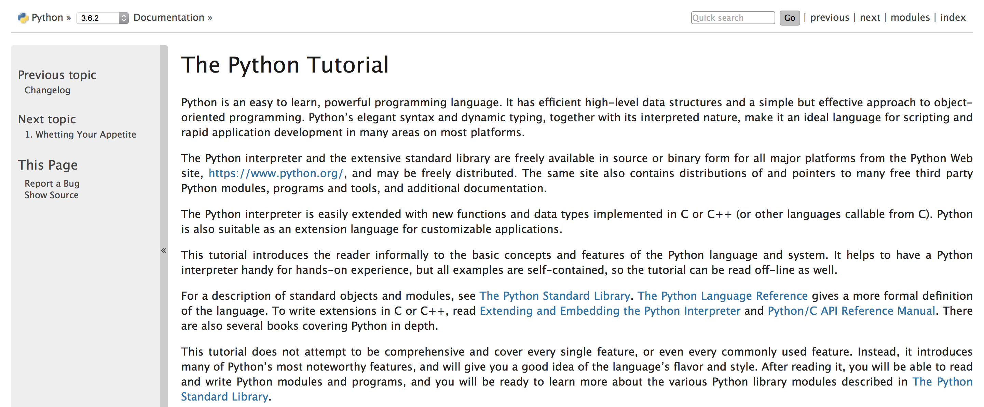
Official tutorial website
https://docs.python.org/3/tutorial/index.html

Slide 8
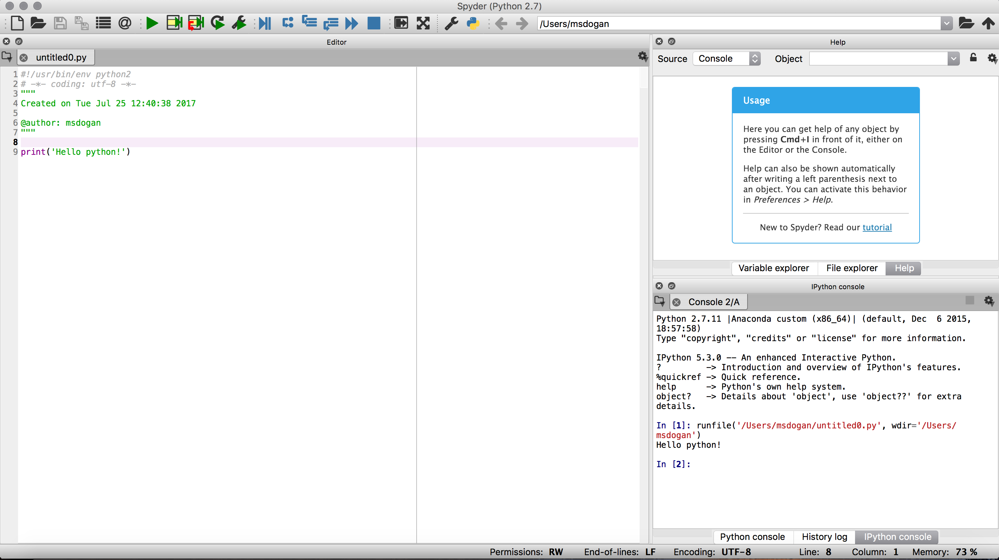
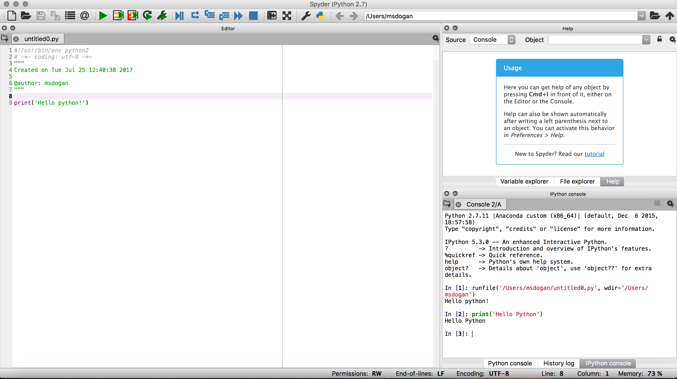
First Command: Hello Python!
Type print(’Hello Python’) to script editor and run (F5)
Type print(’Hello Python’) to console and hit ‘enter’
Script editor
Console

Slide 9
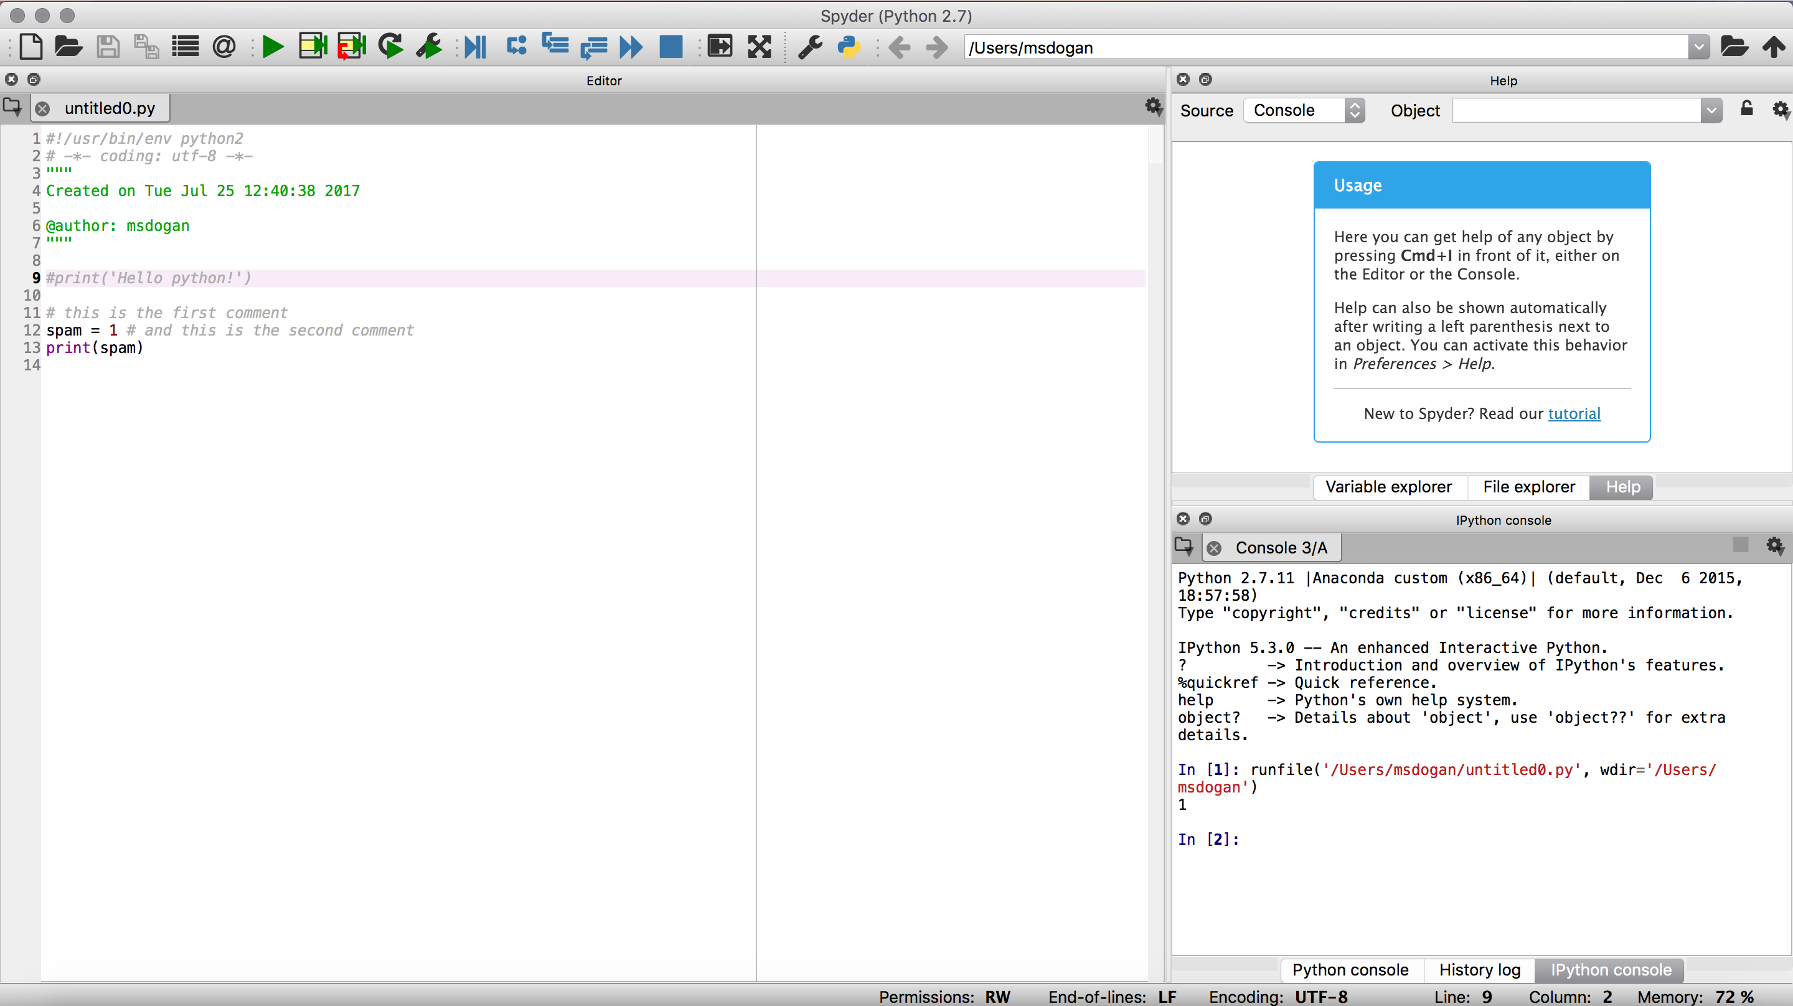
Creating & printing variables & inserting comment (#)
# this is the first comment
spam = 1 # and this is the second comment
print(spam)

Slide 10
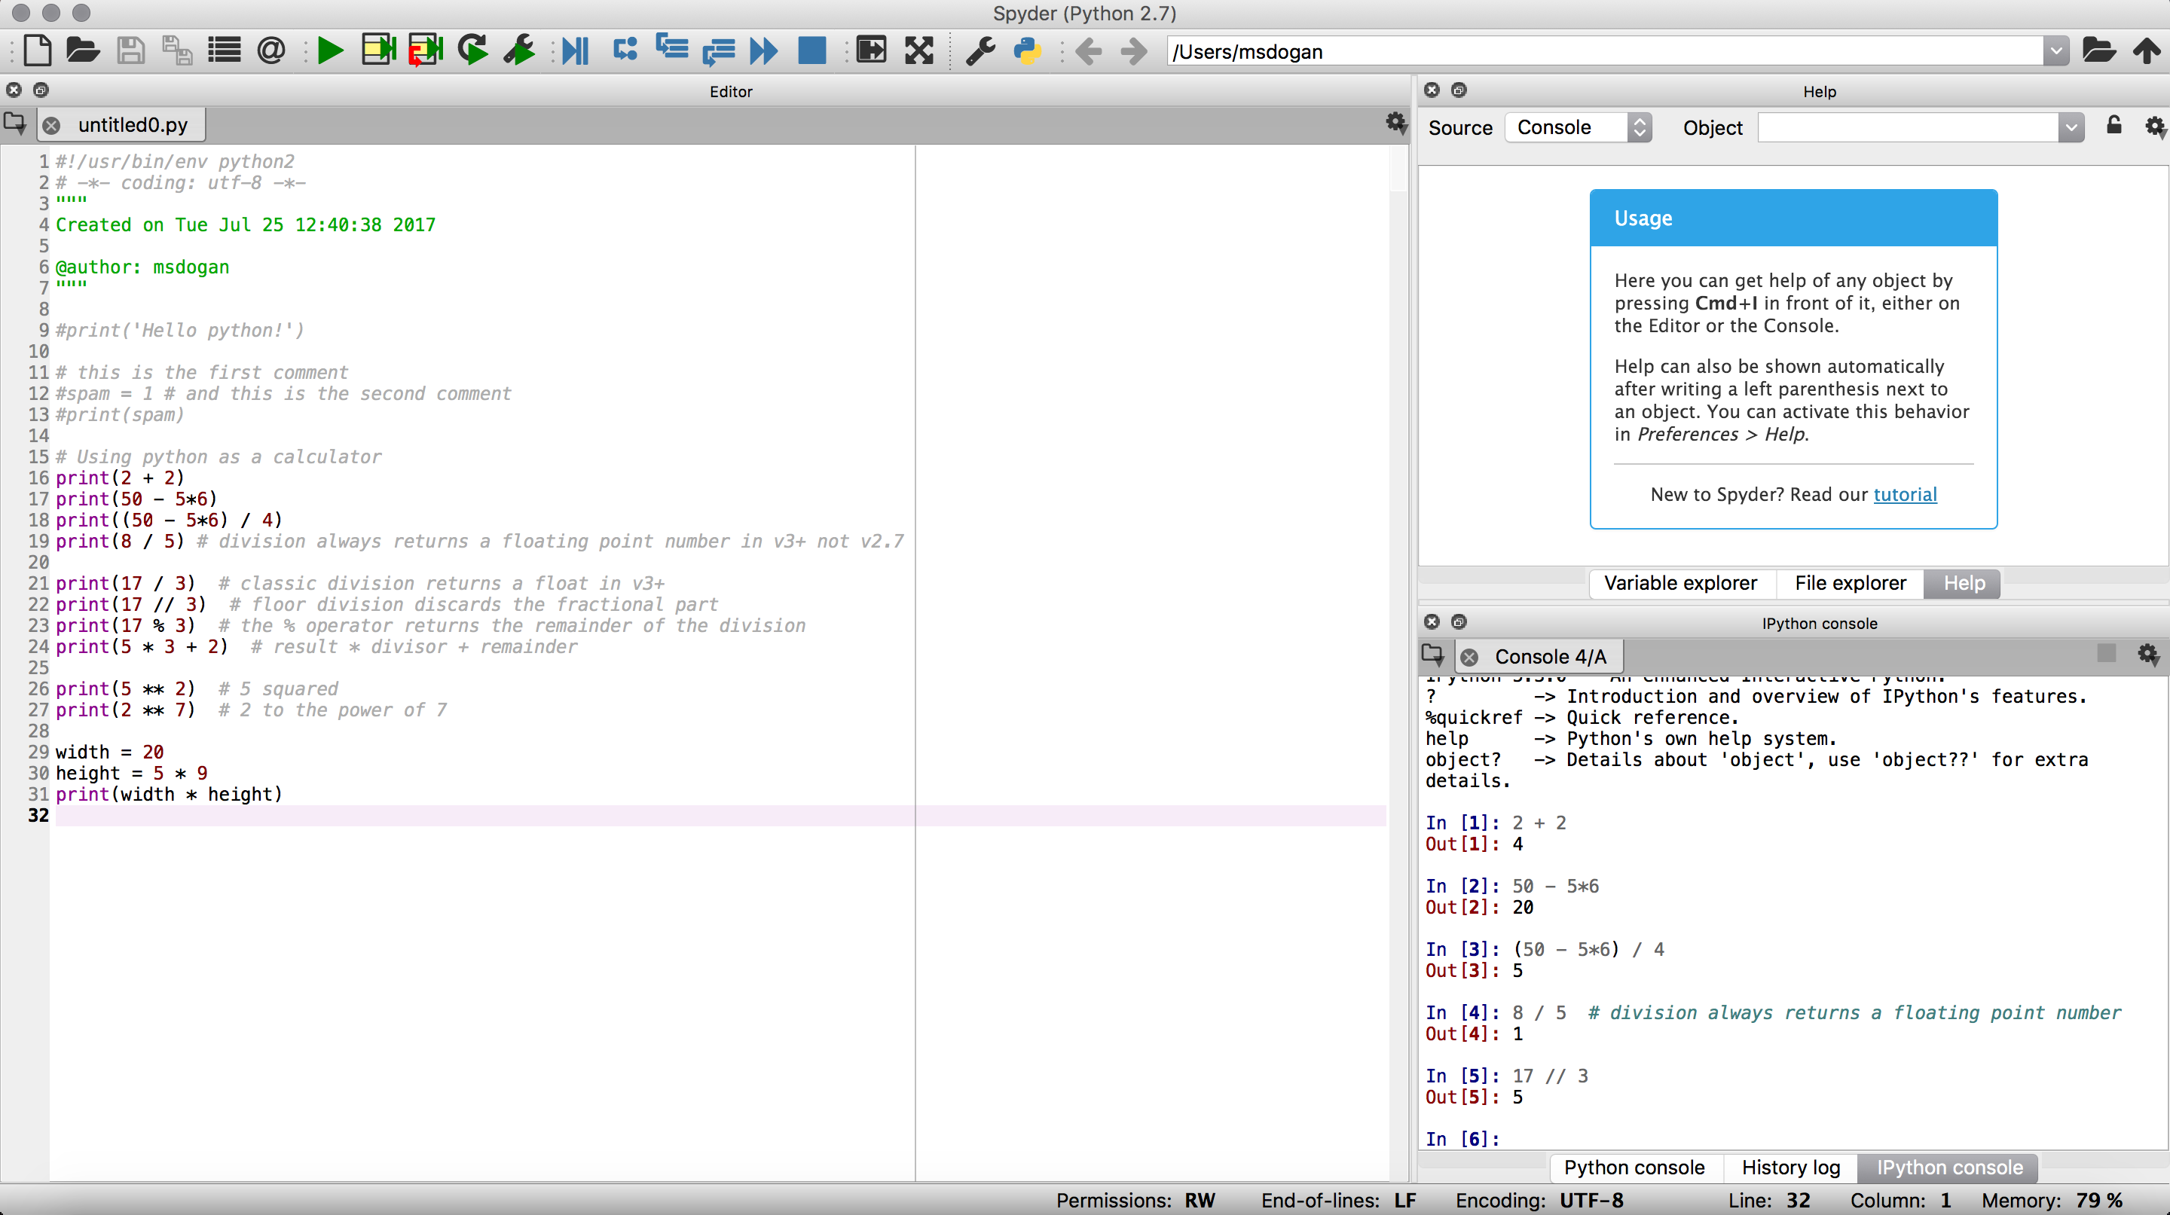
Using Python as a calculator

Slide 11
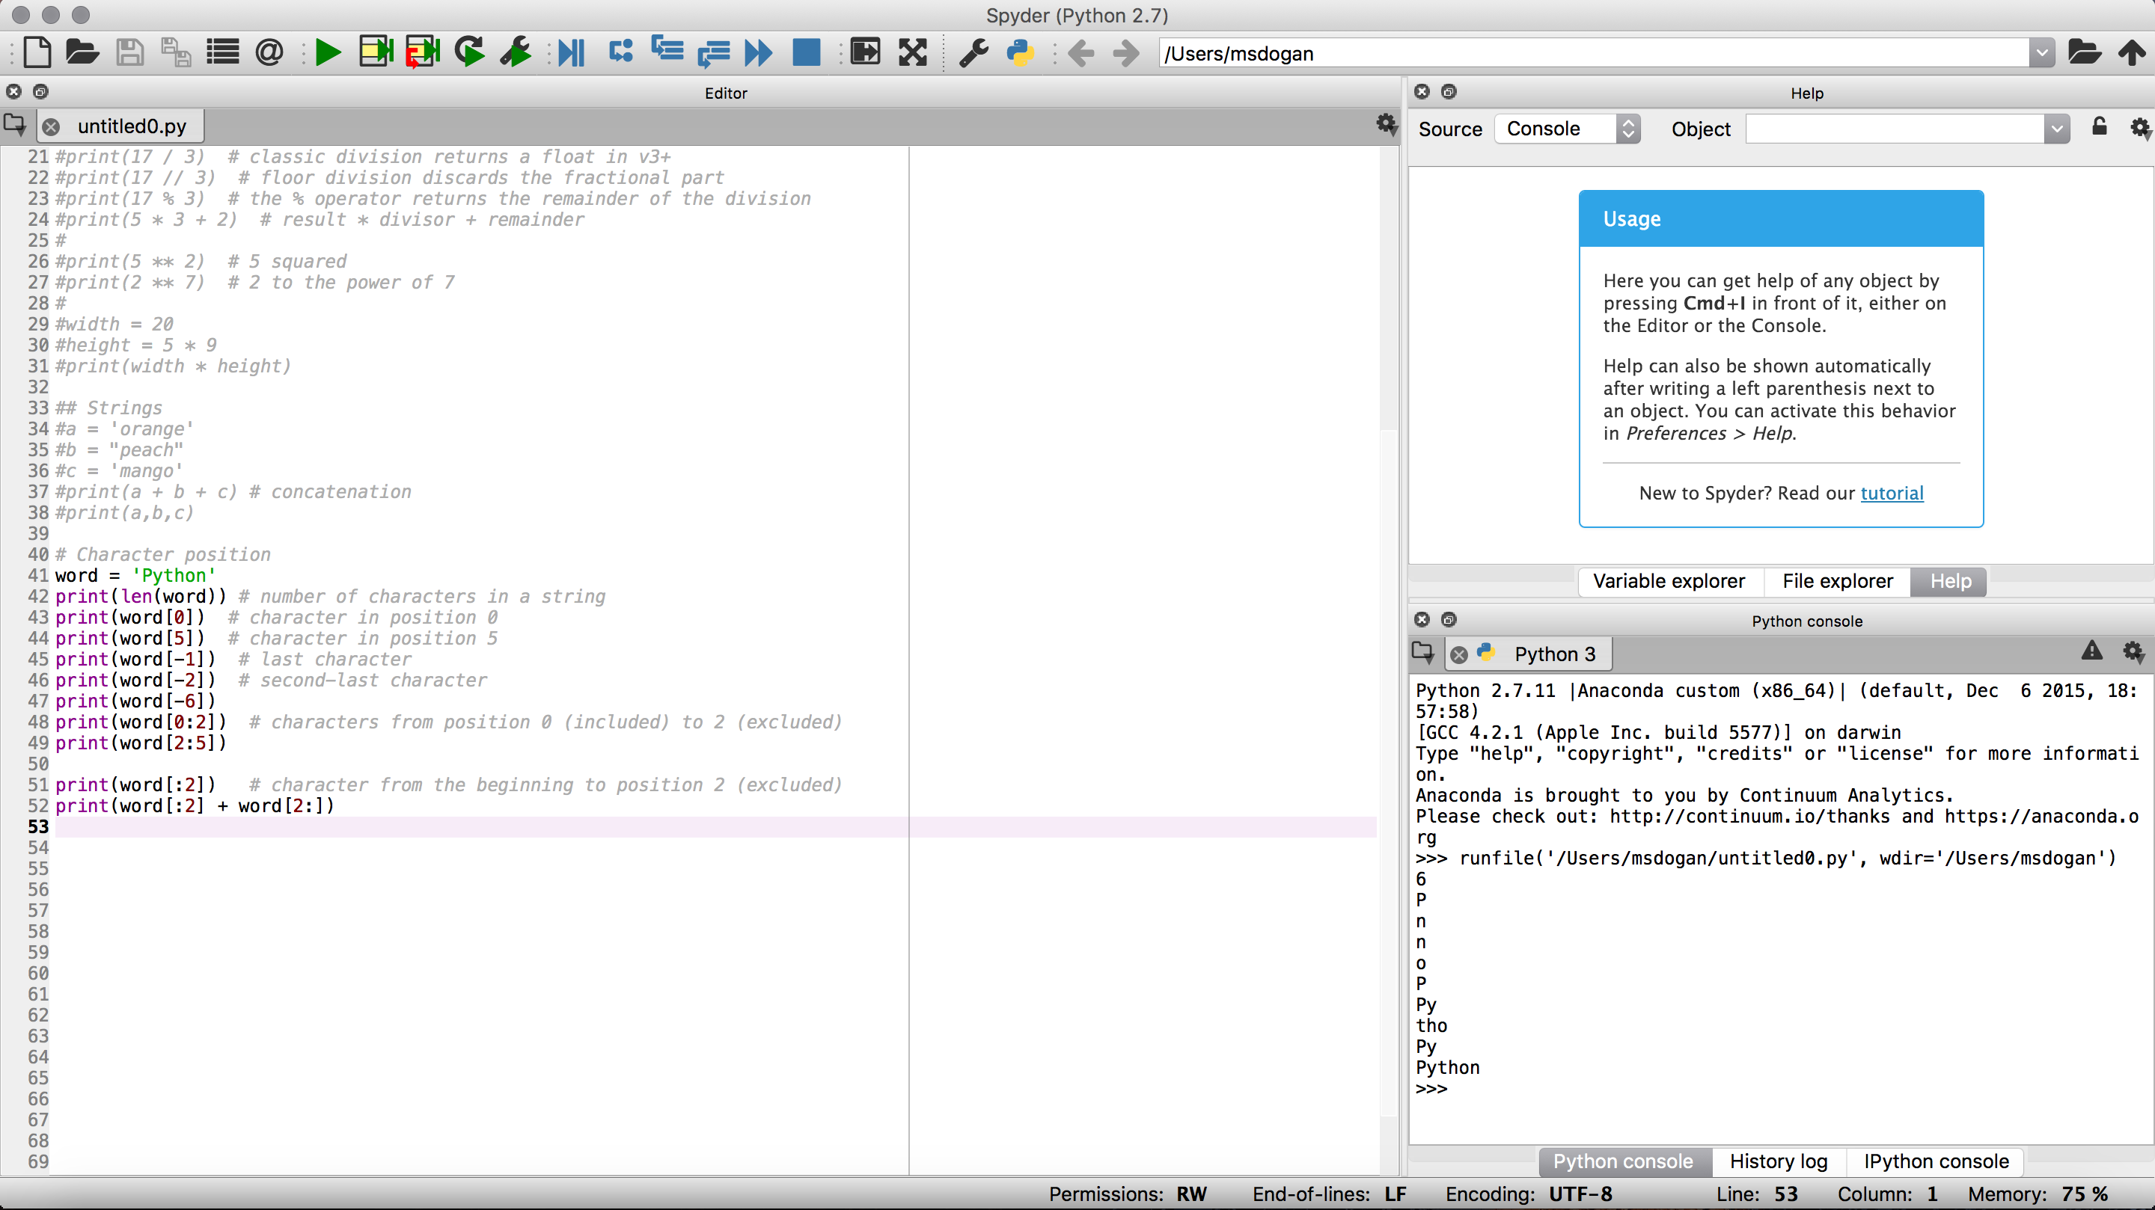
Strings
Strings must be enclosed in single ‘’ or double ”” quotes

Slide 12
Ways to group, store and recall data
List: []
Set: {}
Dictionary: {}
Array: np.array() (requires Numpy package)
Dataframe: pd.DataFrame() (requires Pandas package)

Slide 13
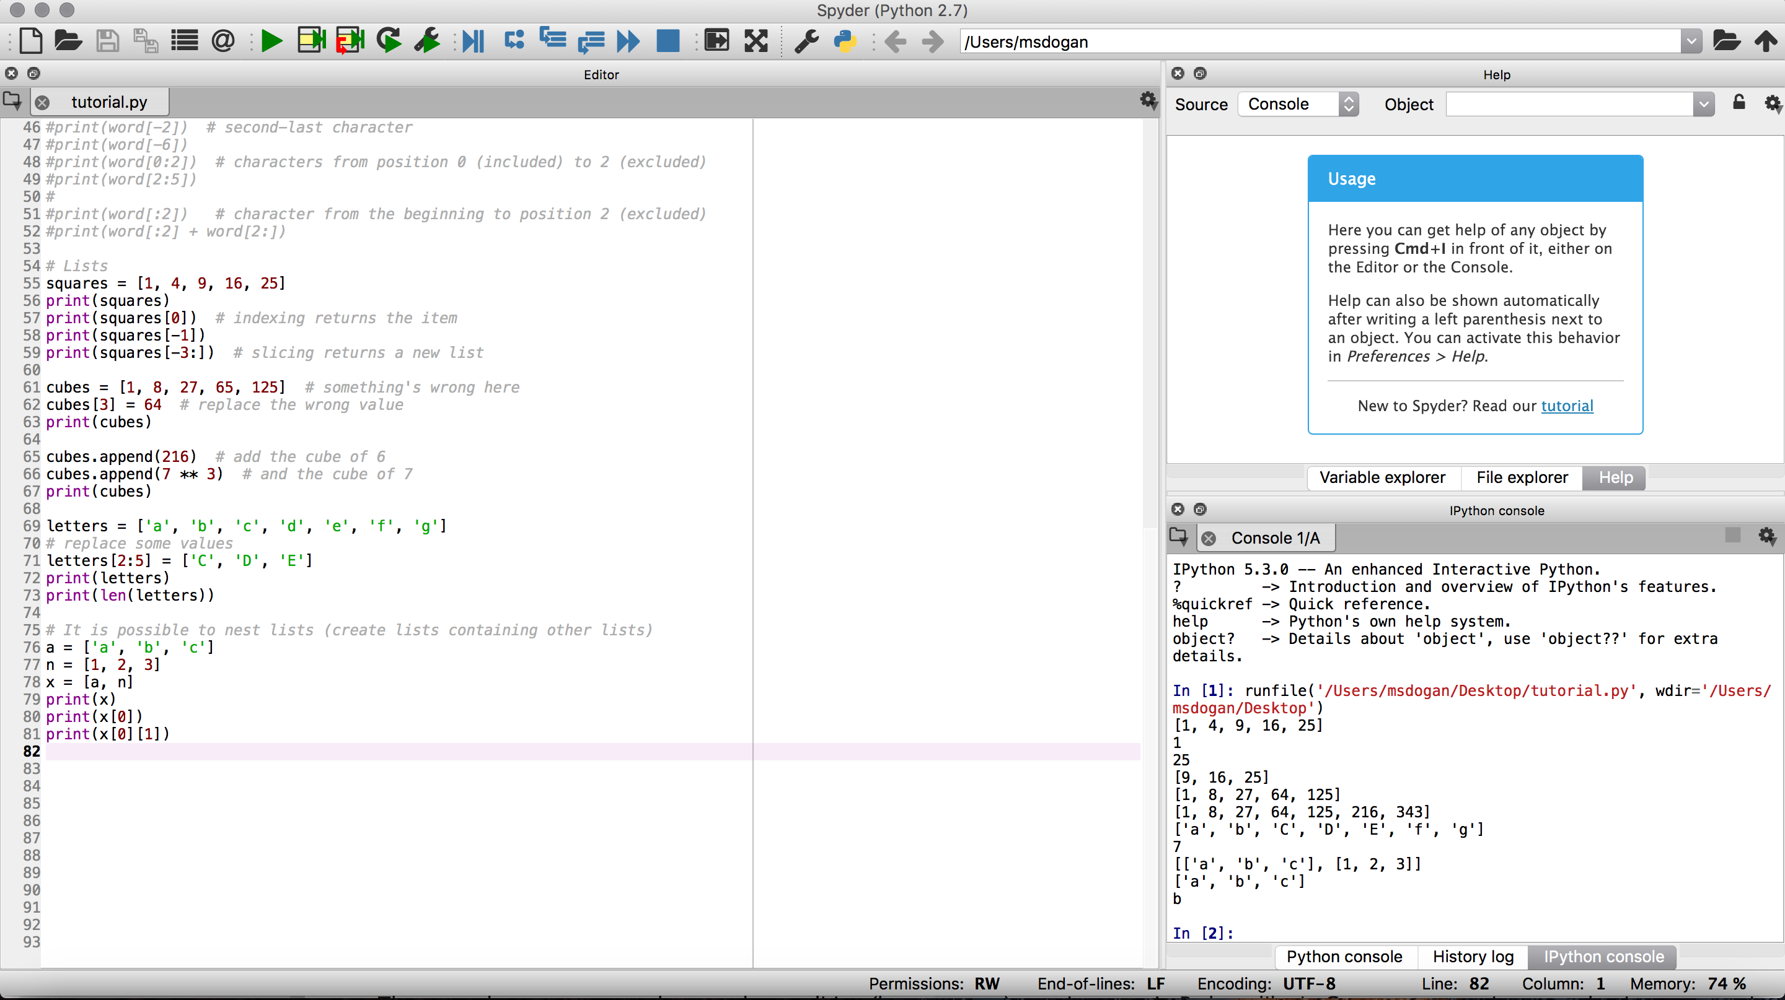
Lists
Python knows a number of compound data types, used to group together other values. The most versatile is the list, which can be written as a list of comma-separated values (items) between square brackets.

Slide 14
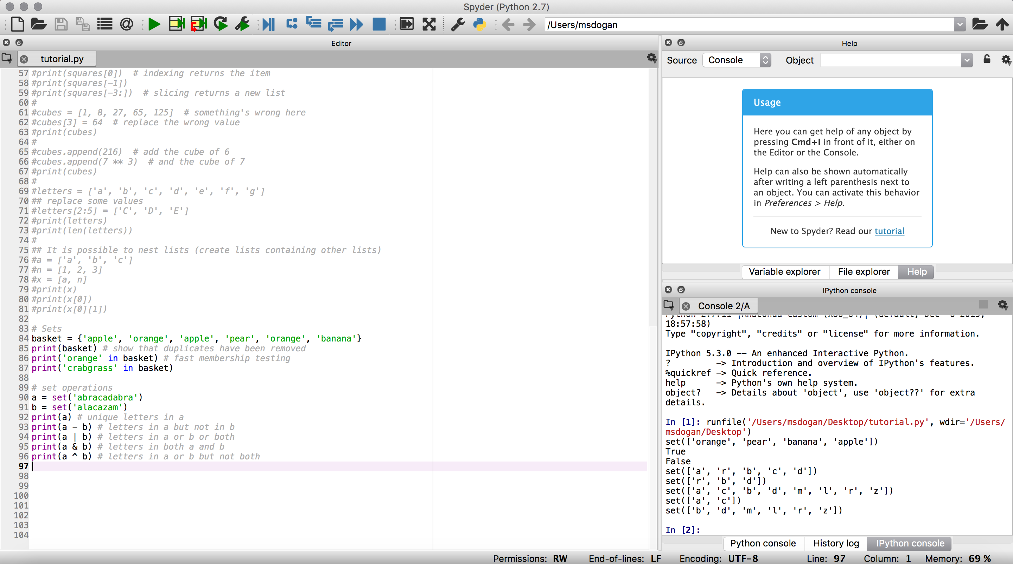
Sets
A set is an unordered collection with no duplicate elements
Sets support mathematical operations like union, intersection, difference, and symmetric difference

Slide 15
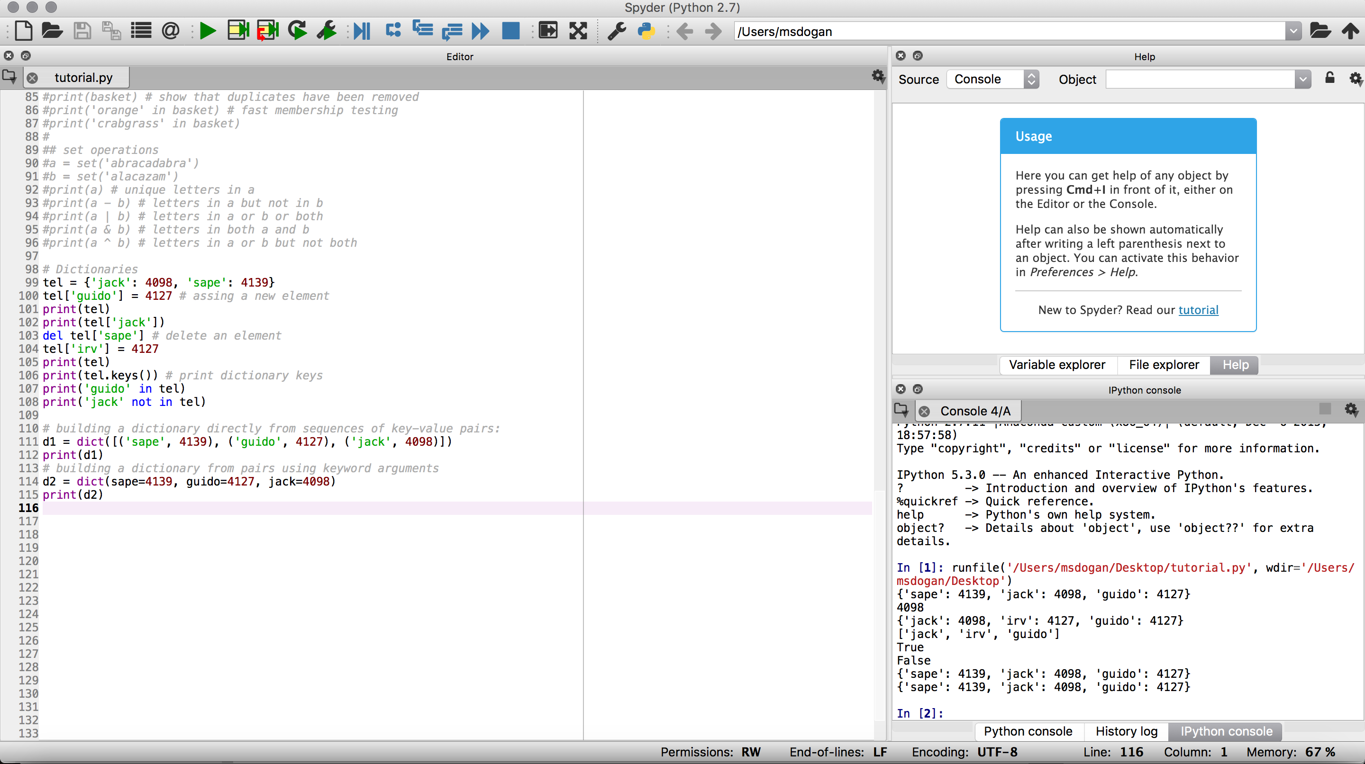
Dictionaries
Dictionaries are indexed by keys
The main operations on a dictionary are storing a value with some key and extracting the value given the key

Slide 16
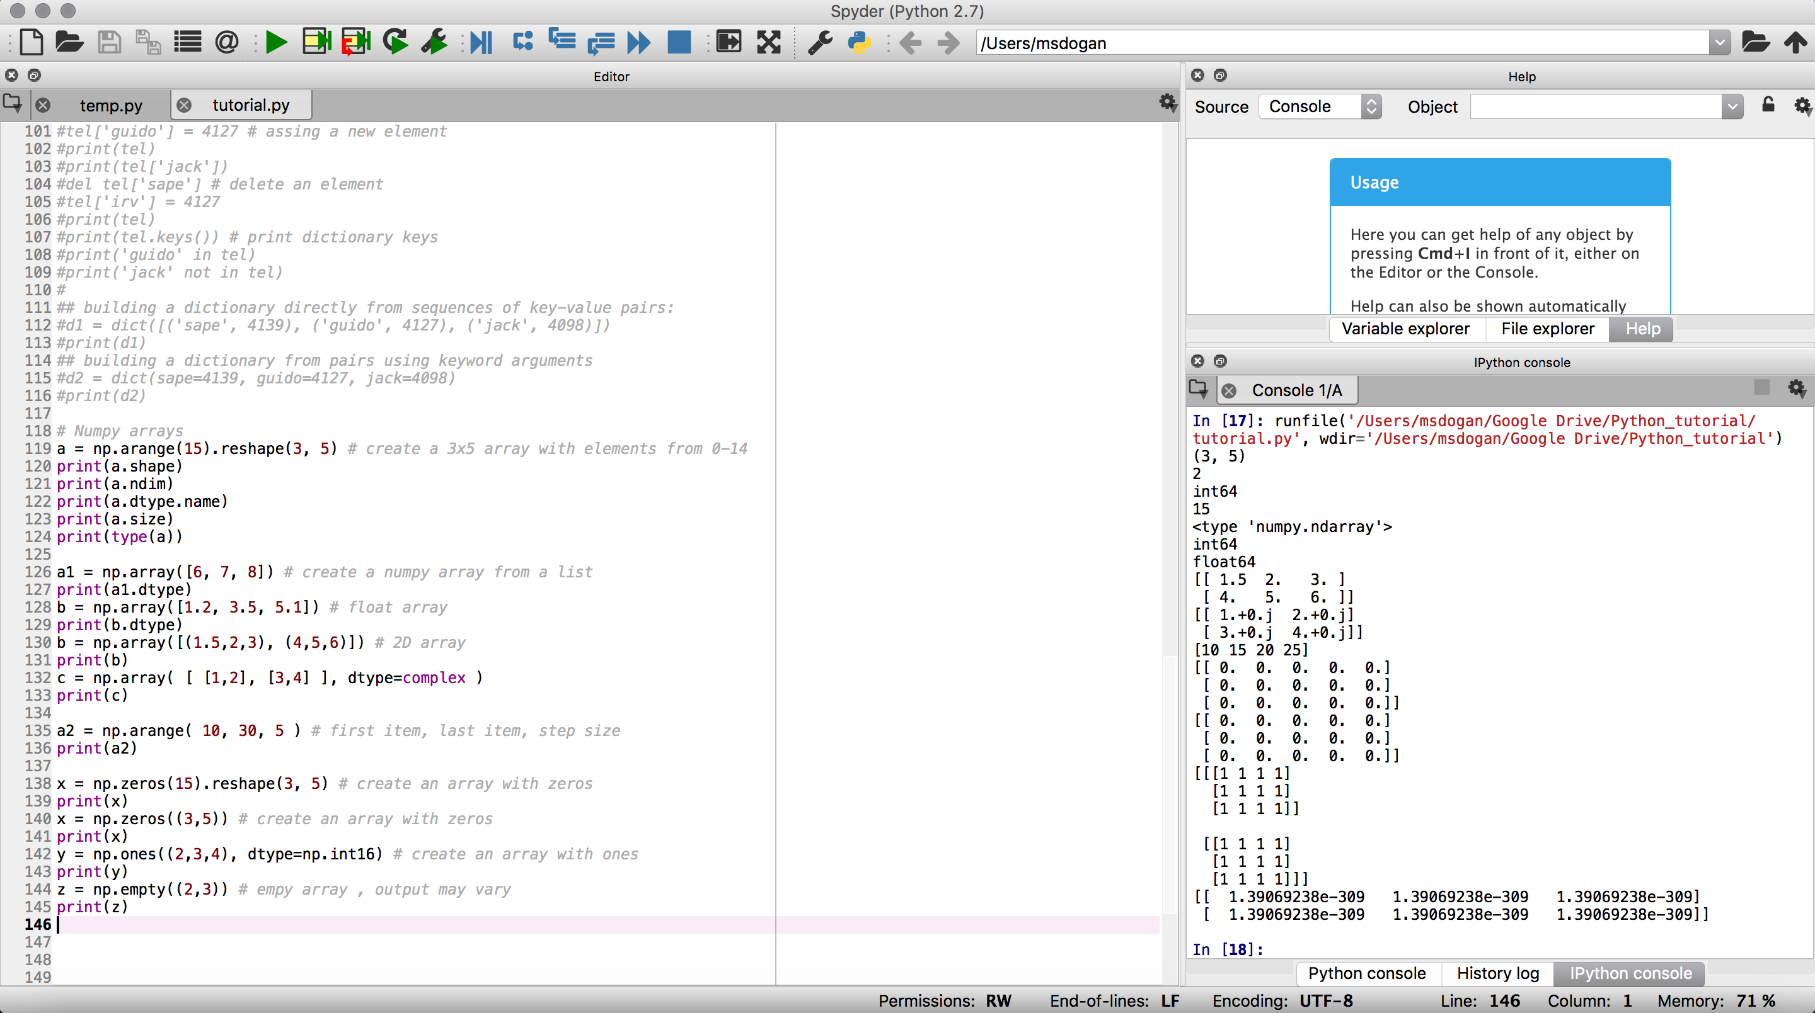
Numpy Arrays np.array()
import numpy as np
Homogeneous multidimensional array
Table of elements, all of the same type

Slide 17
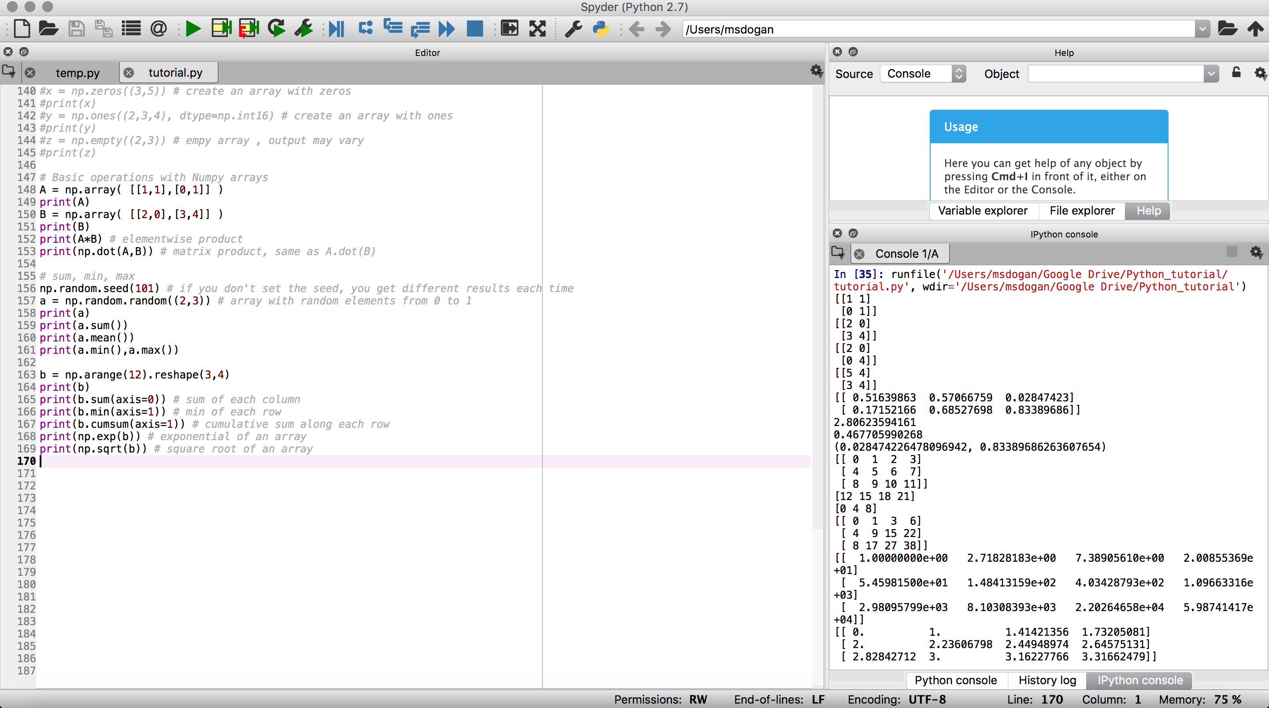
Some operations w/ Numpy arrays

Slide 18
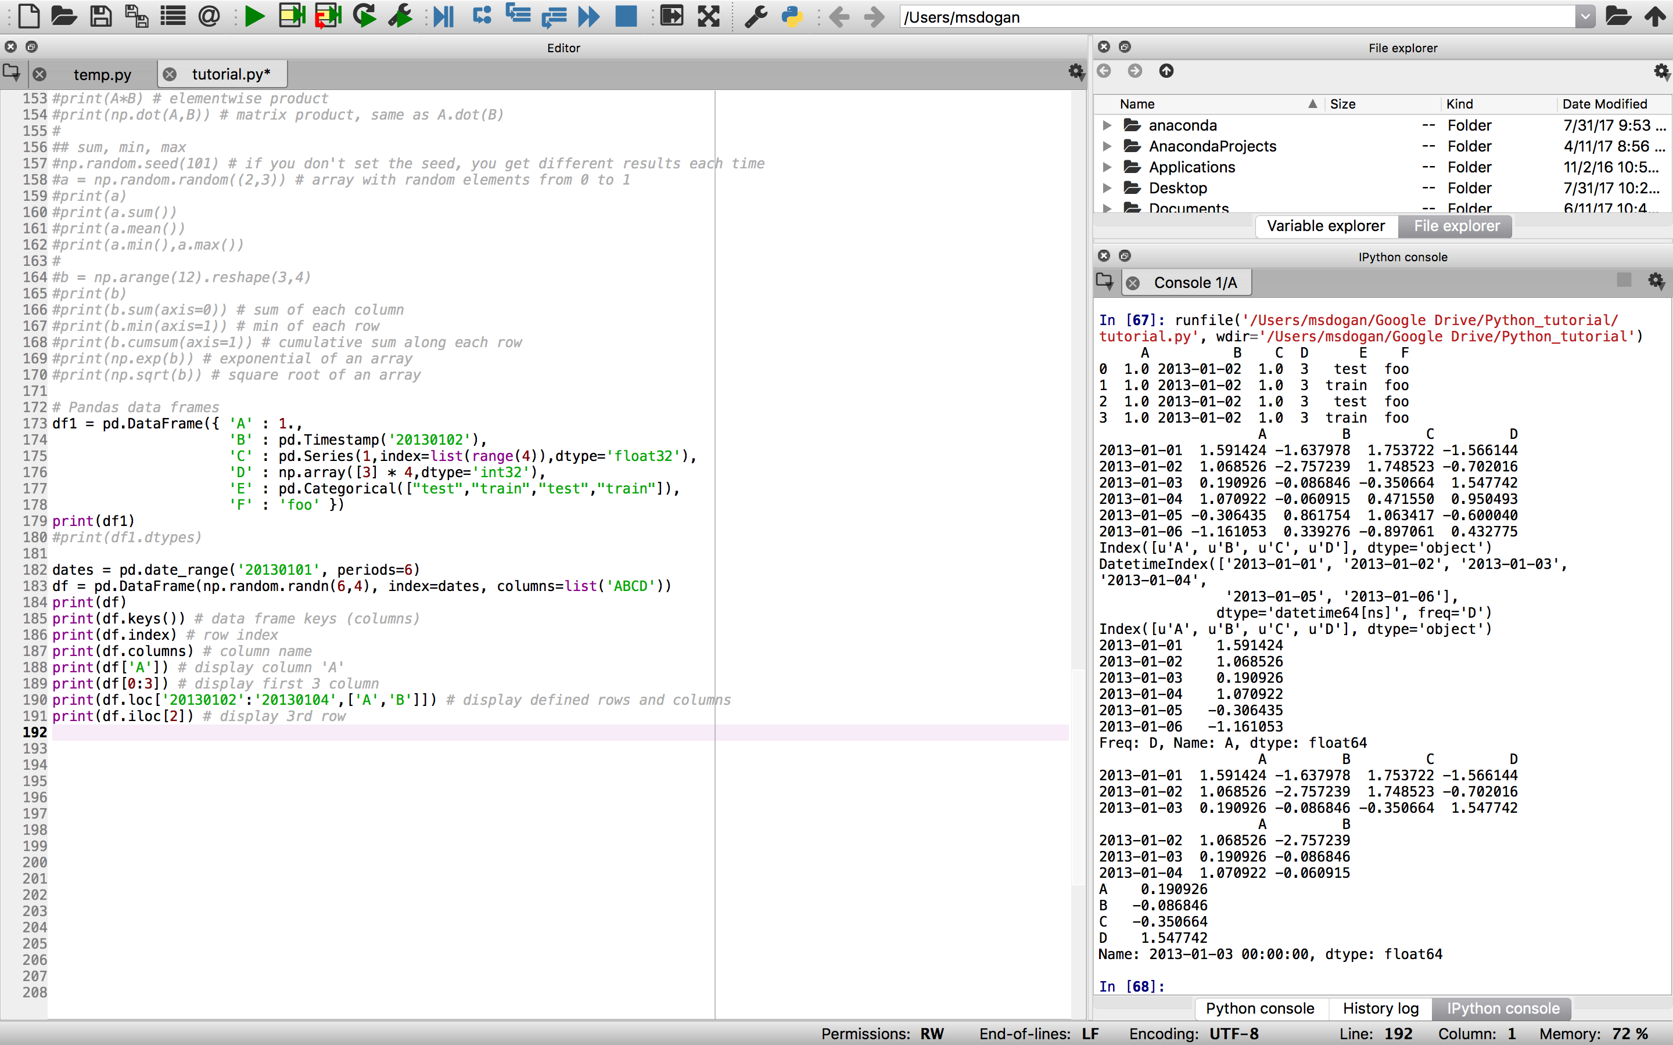
Pandas data frames pd.DataFrame()
import pandas as pd
Tabular data structure with labeled columns & rows
Dictionary-like container for series objects

Slide 19
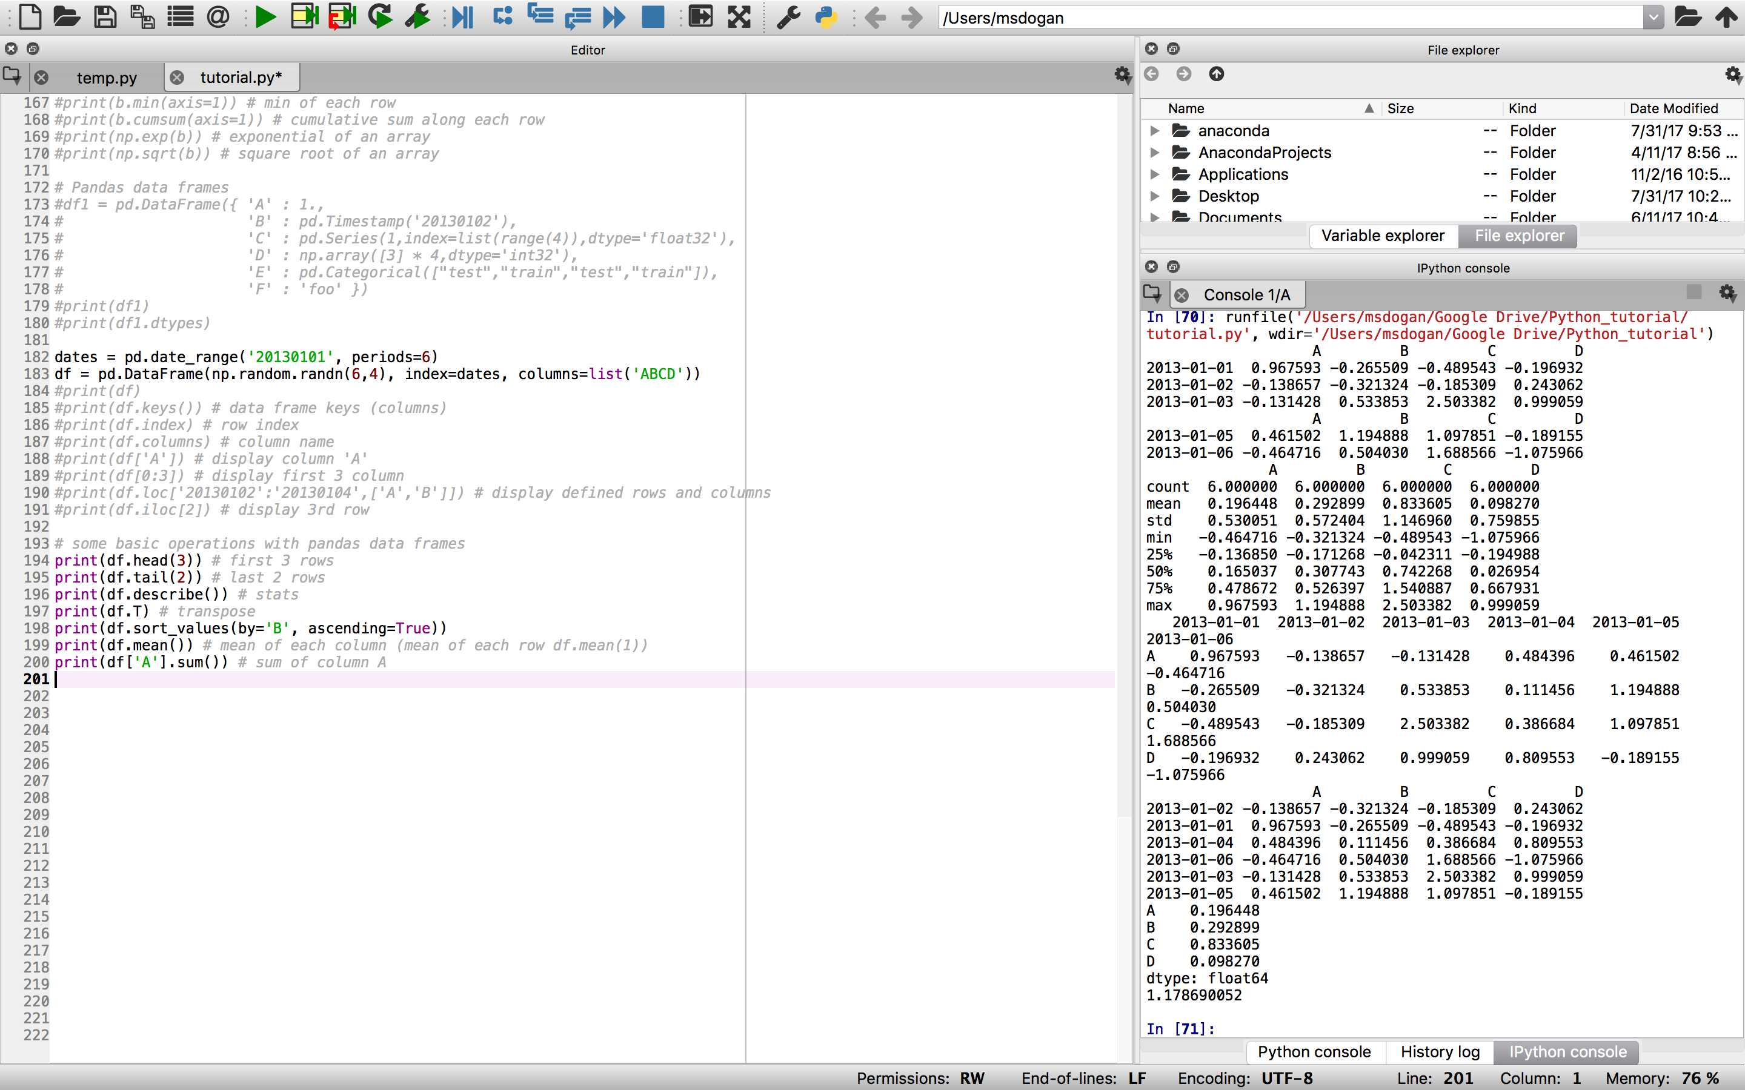
Some operations w/ Pandas dataframes

Slide 20
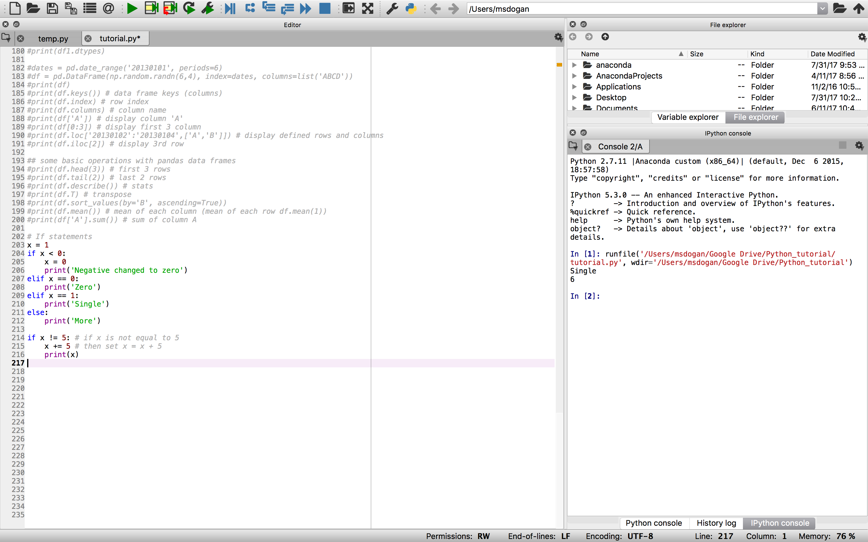
if statements: if, elif, else
Less than: <
Greater than: >
Equal: ==
Not equal: !=

Slide 21
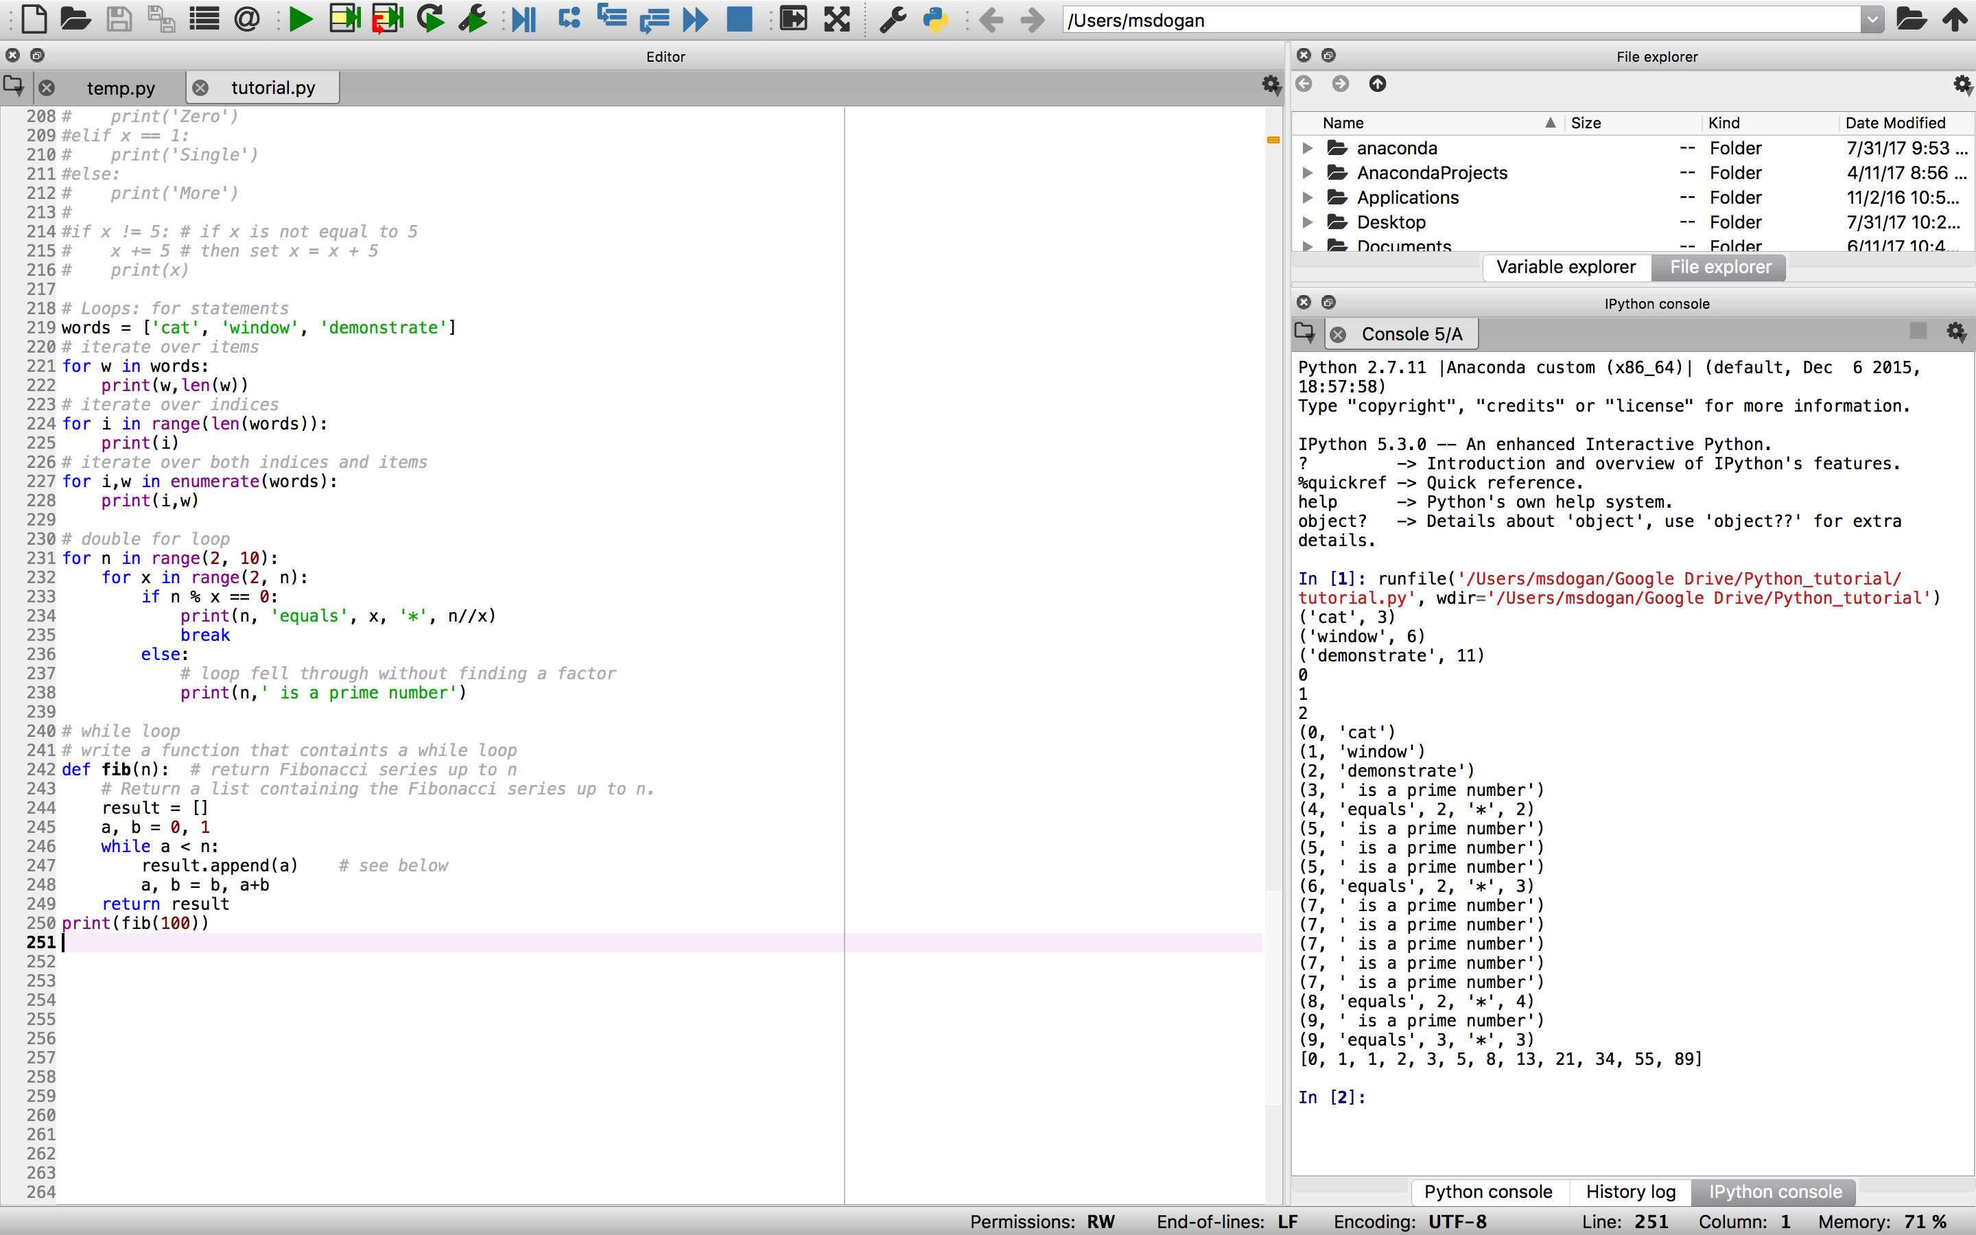
Loops: for & while statements
For loops: Iterate over the items of any sequence (a list or a string), in the order that they appear in the sequence
While loops: continue until exit criteria met

Slide 22
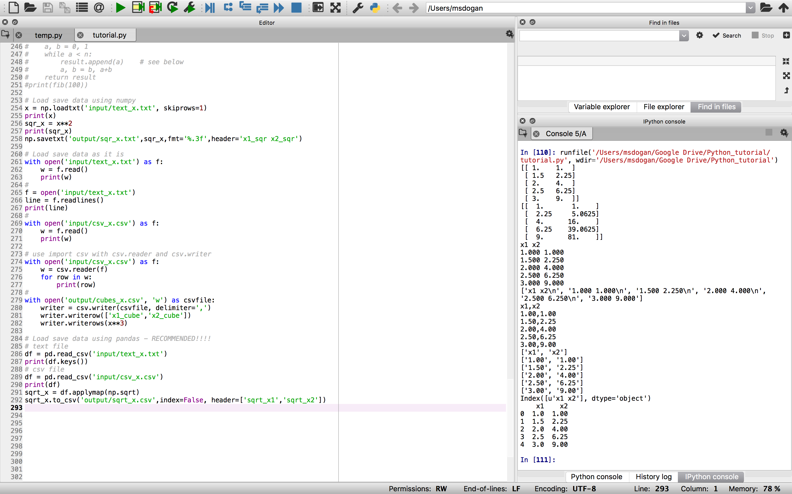
Loading & saving data
Load / save data from / to csv and txt
A few different ways: numpy, csv, and pandas

Slide 23
Data visualization

